Slide 1
Digital Signal Processing(BEC-42)
Unit-1
Lecture-3
Presented By:
Dr. Satish Chandra

Slide 2
Fourier Analysis of Discrete Time Signals
For a discrete time sequence we define two classes of Fourier Transforms:
DTFT (Discrete Time Fourier Transform) for sequences having infinite duration which relate the time and frequency domain
DFT (Discrete Fourier Transform) for sequences having finite duration.

Slide 3
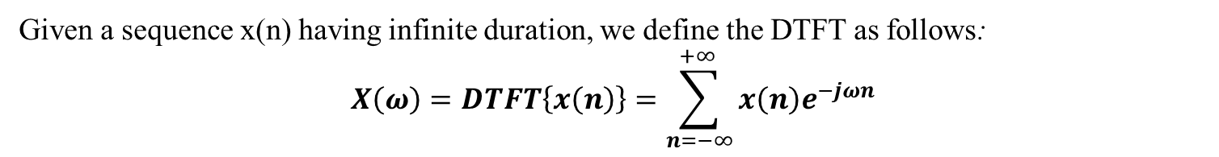
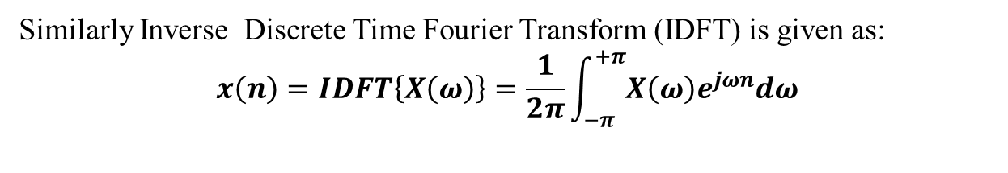
The Discrete Time Fourier Transform (DTFT)
Given a sequence x(n) having infinite duration, we define the DTFT as follows:
$$X\left(ω\right)=DTFT\left\{x\left(n\right)\right\}=\sum_{n=−∞}^{+∞ }{x\left(n\right)e^{−jωn}}$$
Similarly Inverse Discrete Time Fourier Transform (IDFT) is given as:
$$x\left(n\right)=IDFT\left\{X\left(ω\right)\right\}=\frac{1}{2π}\int_{−π}^{+π}{X\left(ω\right)e^{jωn}dω}$$
…..
…..
discrete time
continuous frequency

Slide 4
Observations:
The DTFT is periodic with period ;
The frequency is the digital frequency and therefore it is limited to the interval
Recall that the digital frequency is a normalized frequency relative to the sampling frequency, defined as
one period of

Slide 5
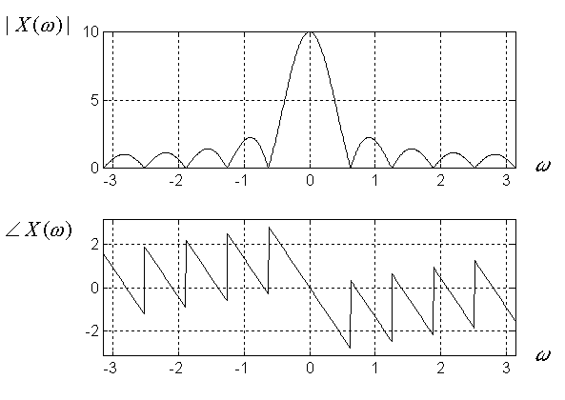
Example:
since

Slide 6
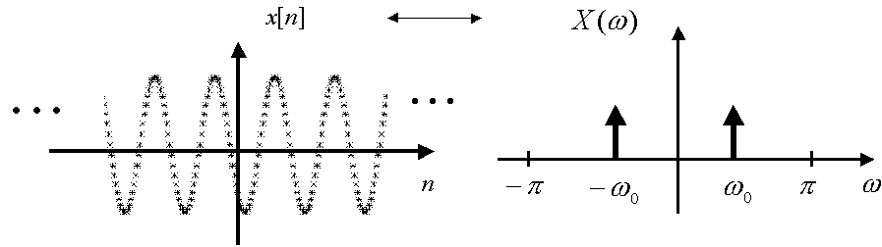
Example:

Slide 7
Frequency Domain Sampling: Discrete Fourier Transform (DFT)
Definition (Discrete Fourier Transform): Given a finite sequence
its Discrete Fourier Transform (DFT) is a finite sequence
where
DFT

Slide 8
Definition (Inverse Discrete Fourier Transform): Given a sequence
its Inverse Discrete Fourier Transform (IDFT) is a finite sequence
where
IDFT

Slide 9
Observations:
The DFT and the IDFT form a transform pair.
DFT
IDFT
back to the same signal !
The DFT is a numerical algorithm, and it can be computed by a digital computer.

Slide 10
DFT as a Vector Operation
Let
Then:

Slide 12
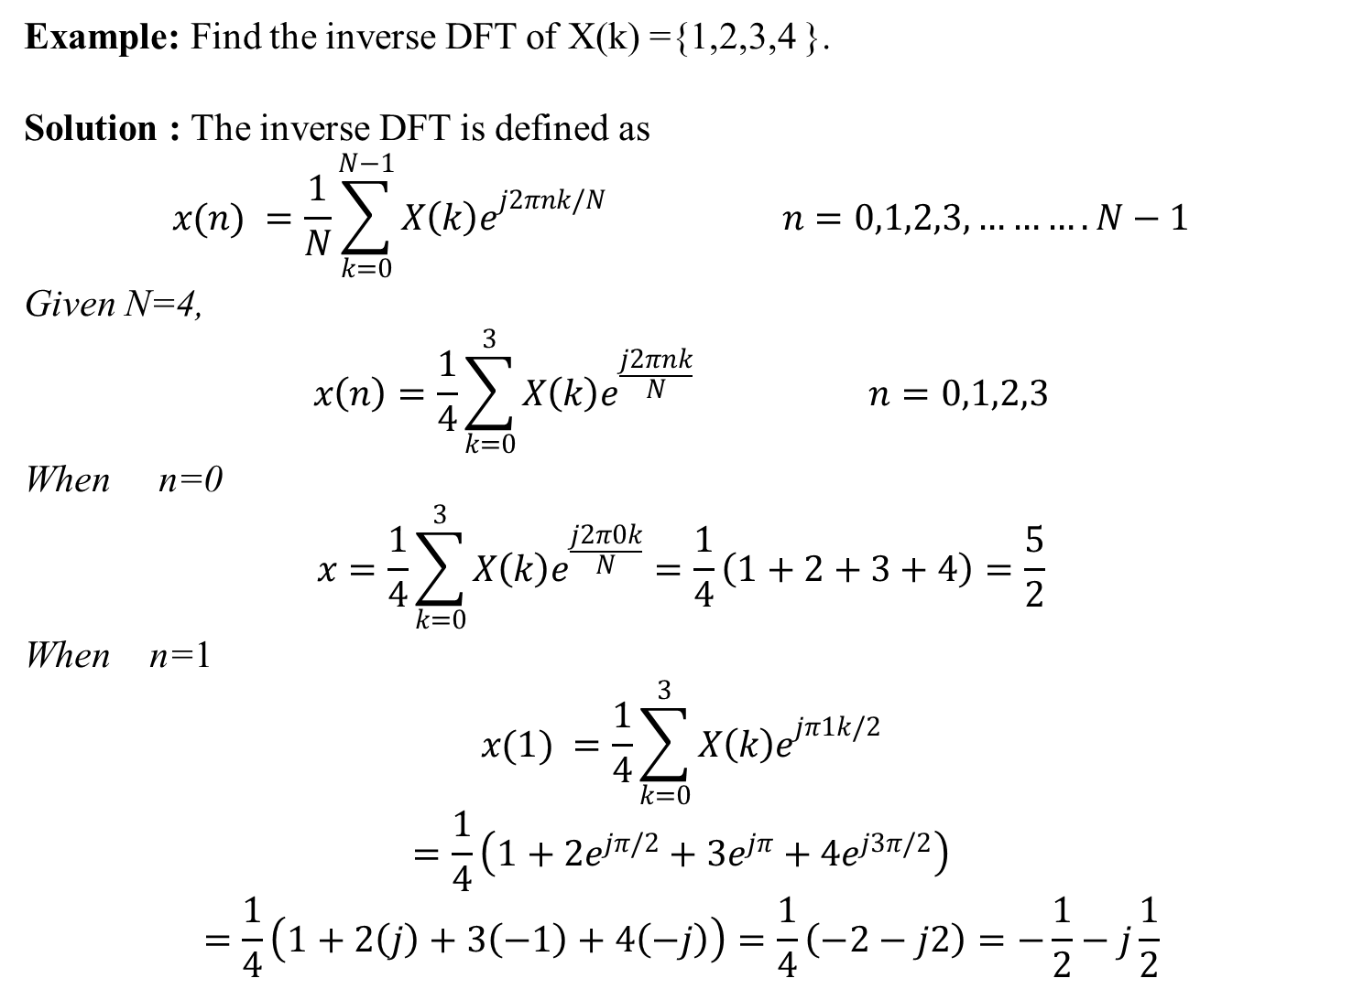
Example: Find the inverse DFT of X(k) ={1,2,3,4 }.
Solution : The inverse DFT is defined as
$$x(n) =\frac{1}{N}\sum_{k=0}^{N−1}{{X\left(k\right)e}^{j2πnk/N} n=0,1,2,3,……….N−1}$$
Given N=4,
$$x\left(n\right)=\frac{1}{4}\sum_{k=0}^{3}{{X\left(k\right)e}^{\frac{j2πnk}{N}} n=0,1,2,3}$$
When n=0
$$x=\frac{1}{4}\sum_{k=0}^{3}{{X\left(k\right)e}^{\frac{j2π0k}{N}}}=\frac{1}{4}\left(1+2+3+4\right)=\frac{5}{2}$$
When n=1
$$x(1) =\frac{1}{4}\sum_{k=0}^{3}{{X\left(k\right)e}^{jπ1k/2}}$$
$$=\frac{1}{4}\left(1+2e^{jπ/2}+3e^{jπ}+4e^{j3π/2}\right)$$
$$=\frac{1}{4}\left(1+2\left(j\right)+3\left(−1\right)+4\left(−j\right)\right)=\frac{1}{4}\left(−2−j2\right)=−\frac{1}{2}−j\frac{1}{2}$$

Slide 13

When n=2
$$x(2) =\frac{1}{4}\sum_{k=0}^{3}{{X\left(k\right)e}^{jπk}}$$
$$=\frac{1}{4}\left(1+2e^{jπ}+3e^{j2π}+4e^{j3π}\right)$$
$$=\frac{1}{4}\left(1+2\left(−1\right)+3\left(1\right)+4\left(−1\right)\right)=\frac{1}{4}\left(−2\right)=−\frac{1}{2}$$
When n=3
$$x(3) =\frac{1}{4}\sum_{k=0}^{3}{{X\left(k\right)e}^{j3πk/2}}$$
$$=\frac{1}{4}\left(1+2e^{j3π/2}+3e^{j3π}+4e^{j9π/2}\right)$$
$$=\frac{1}{4}\left(1+2\left(−j\right)+3\left(−1\right)+4\left(j\right)\right)=\frac{1}{4}\left(−2+j2\right)=−\frac{1}{2}+j\frac{1}{2}$$
$$x\left(n\right)=\left\{\frac{5}{2},−\frac{1}{2}−j\frac{1}{2},−\frac{1}{2},−\frac{1}{2}+j\frac{1}{2}\right\}$$

